Slide 1
CSBP 301: Artificial Intelligence (Ch.2)
Dr. Fady Alnajjar
CIT, UAEU

Slide 2
Outline
Intelligent Agents (IA)
Environment types
IA Behavior
IA Structure
IA Types

Slide 3
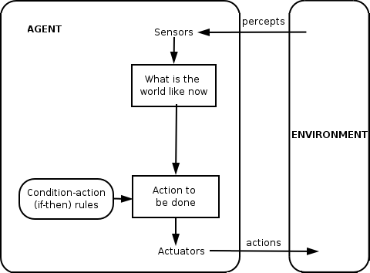
What is an (Intelligent) Agent?
Anything that can be viewed as perceiving its environment through sensors and acting upon that environment through its effectors to maximize progress towards its goals.
Notes:
Wikipedia
Search Agent: tracking system is that you can categorize your searches to make it easier for you in the future.
Emg and Vibrators.
Drons.
https://www.tutorialspoint.com/artificial_intelligence/artificial_intelligence_agents_and_environments.htm

Slide 4
What is an (Intelligent) Agent?
PAGE (Percepts, Actions, Goals, Environment)
Task-specific & specialized: well-defined goals and environment
The notion of an agent is meant to be a tool for analyzing systems,
It is not a different hardware or new programming languages
Notes:
Goal is why we are doing this.
Environment: what factors we have to consider.

Slide 5
Agents
An agent is anything that can be viewed as perceiving its environment through sensors and acting upon that environment through actuators
Human agent: eyes, ears, and other organs for sensors; hands,
legs, mouth, and other body parts for actuators
Robotic agent: cameras and infrared range finders for sensors;
various motors for actuators

Slide 6
Rational agents
An agent should strive to "do the right thing", based on what it can perceive and the actions it can perform. The right action is the one that will cause the agent to be most successful
Performance measure: An objective criterion for success of an agent's behavior
E.g., performance measure of a vacuum-cleaner agent could be amount of dirt cleaned up, amount of time taken, amount of electricity consumed, amount of noise generated, etc.

Slide 7
Rational agents
Rational Agent: For each possible percept sequence, a rational agent should select an action that is expected to maximize its performance measure, given the evidence provided by the percept sequence and whatever built-in knowledge the agent has.

Slide 8
Rational agents
Rationality is distinct from omniscience (all-knowing with infinite knowledge)
Agents can perform actions in order to modify future percepts so as to obtain useful information (information gathering, exploration)
An agent is autonomous if its behavior is determined by its own experience (with ability to learn and adapt)

Slide 9
Intelligent Agents and Artificial Intelligence
Example: Human mind as network of thousands or millions of agents working in parallel. To produce real artificial intelligence, this school holds, we should build computer systems that also contain many agents and systems for arbitrating among the agents' competing results.
Distributed decision-making and control
Challenges:
Action selection: What next action to choose
Conflict resolution
Agency
sensors
effectors
Notes:
Agent that tell me when I am hungry,
Agent tell when I have to sleep/ go to the bathroom, shower, call my mother..
Orchestra and mistro.
Decision making… complicated/ I have to drink, but I am in a class room.
Parents teaches children how to control their Agents.

Slide 10
Agent Types
We can split agent research into two main strands:
Distributed Artificial Intelligence (DAI) – Multi-Agent Systems (MAS) (1980 – 1990)
Much broader notion of "agent" (1990’s – present)
interface, reactive, mobile, information
Notes:
Search agent.
Lay detector, is it intelligent agent? Who make the decision?

Slide 11
Rational Agents
How to design this?
Sensors
percepts
Environment
?
Agent
actions
Effectors

Slide 12
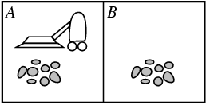
Vacuum-cleaner world
Percepts: location and contents, e.g., [A,Dirty]
Actions: Left, Right, Clean, NoOp

Slide 13
PEAS
PEAS: Performance measure, Environment, Actuators, Sensors
Must first specify the setting for intelligent agent design
Consider, e.g., the task of designing an automated taxi driver:
Performance measure
Environment
Actuators
Sensors

Slide 14
PEAS
Must first specify the setting for intelligent agent design
Consider, e.g., the task of designing an automated taxi driver:
Performance measure: Safe, fast, legal, comfortable trip, maximize profits
Environment: Roads, other traffic, pedestrians, customers
Actuators: Steering wheel, accelerator, brake, signal, horn
Sensors: Cameras, sonar, speedometer, GPS, odometer, engine sensors, keyboard

Slide 15
PEAS
Agent: Medical diagnosis system
Performance measure: Healthy patient, minimize costs, lawsuits
Environment: Patient, hospital, staff
Actuators: Screen display (questions, tests, diagnoses, treatments, referrals)
Sensors: Keyboard (entry of symptoms, findings, patient's answers)

Slide 16
PEAS
Agent: Part-picking robot
Performance measure: Percentage of parts in correct bins
Environment: Conveyor belt with parts, bins
Actuators: Jointed arm and hand
Sensors: Camera, joint angle sensors

Slide 17
PEAS
Agent: Interactive English tutor
Performance measure: Maximize student's score on test
Environment: Set of students
Actuators: Screen display (exercises, suggestions, corrections)
Sensors: Keyboard

Slide 18
Classes
Russell & Norvig (2003) group agents into five classes based on their degree of perceived intelligence and capability
simple reflex agents
model-based reflex agents
goal-based agents
utility-based agents
learning agents
Notes:
As you go deep, as the model will be more sophisticated.

Slide 19
Classes
simple reflex agents
Simple reflex agents act only on the basis of the current percept, ignoring the rest of the percept history. The agent function is based on the condition-action rule: if condition then action.
model-based reflex agents
goal-based agents
utility-based agents
learning agents
Notes:
As you go deep, as the model will be more sophisticated.

Slide 20
A Windshield Wiper Agent
How do we design a agent that can wipe the windshields
when needed?
Goals?
Percepts?
Sensors?
Effectors?
Actions?
Environment?
Notes:
Change something from simple pre-programmed or manually designed to AI.
Car that stops automatically when there is a danger

Slide 21
A Windshield Wiper Agent (Cont’d)
Goals: Keep windshields clean & maintain visibility
Percepts: Raining, Dirty
Sensors: Camera (moist sensor)
Effectors: Wipers (left, right, back)
Actions: Off, Slow, Medium, Fast
Environment: Inner city, freeways, highways, weather …

Slide 22
Interacting Agents
Collision Avoidance Agent (CAA)
Goals: Avoid running into obstacles
Percepts ?
Sensors?
Effectors ?
Actions ?
Environment: Freeway
Lane Keeping Agent (LKA)
Goals: Stay in current lane
Percepts ?
Sensors?
Effectors ?
Actions ?
Environment: Freeway
Notes:
Common questions.

Slide 23
Interacting Agents
Collision Avoidance Agent (CAA)
Goals: Avoid running into obstacles
Percepts: Obstacle distance, velocity, trajectory
Sensors: Vision, proximity sensing
Effectors: Steering Wheel, Accelerator, Brakes, Horn, Headlights
Actions: Steer, speed up, brake, blow horn, signal (headlights)
Environment: Freeway
Lane Keeping Agent (LKA)
Goals: Stay in current lane
Percepts: Lane center, lane boundaries
Sensors: Vision
Effectors: Steering Wheel, Accelerator, Brakes
Actions: Steer, speed up, brake
Environment: Freeway
Notes:
Controller (maistro).

Slide 24
Conflict Resolution by Action Selection Agents
Override: CAA overrides LKA
Arbitrate: if Obstacle is Close then CAA else LKA
Compromise: Choose action that satisfies both agents
Any combination of the above
Challenges: Doing the right thing
Notes:
Controller (maistro).
Driving to classroom, keep people safe, avoid getting ticket, be on time,.

Slide 25
The Right Thing = The Rational Action
Rational Action: The action that maximizes the expected value of the performance measure given the percept sequence to date
Rational = Best ?
Rational = Optimal ?
Rational = Omniscience ?
Rational = Clairvoyant ?
Rational = Successful ?
Notes:
Before I spend money on this, I have to be sure that I have left money for home rent, etc.
Being Smart (smart system), (rational)

Slide 26
The Right Thing = The Rational Action
Rational Action: The action that maximizes the expected value of the performance measure given the percept sequence to date
Rational = Best Yes, to the best of its knowledge
Rational = Optimal Yes, to the best of its abilities (incl.
Rational ≠ Omniscience its constraints)
Rational ≠ Clairvoyant
Rational ≠ Successful

Slide 27
Behavior and performance of IAs
Perception (sequence) to Action Mapping: f : P* → A
Ideal mapping: specifies which actions an agent ought to take at any point in time
Description: Look-Up-Table, Closed Form, etc.
Performance measure: a subjective measure to characterize how successful an agent is (e.g., speed, power usage, accuracy, money, etc.)
(degree of) Autonomy: to what extent is the agent able to make decisions and take actions on its own?
Notes:
If raining, start, if not stop/
Less controlled by human (automated system, semi-automated system).

Slide 28
Look up table
Distance | Action
10 | No action
5 | Turn left 30 degrees
2 | Stop
obstacle
sensor
agent

Slide 29
Closed form
Output (degree of rotation) = F(distance)
E.g., F(d) = 10/d (distance cannot be less than 1/10)

Slide 30
How is an Agent different from other software?
Agents are autonomous, that is, they act on behalf of the user
Agents contain some level of intelligence, from fixed rules to learning engines that allow them to adapt to changes in the environment
Agents don't only act reactively, but sometimes also proactively
Notes:
Agent is to act instead of a User.
Ask Google, acting on your behalf. Spell check.
Proactively: traffic sign, fire detectors (different colors)

Slide 31
How is an Agent different from other software?
Agents have social ability, that is, they communicate with the user, the system, and other agents as required
Agents may also cooperate with other agents to carry out more complex tasks than they themselves can handle
Agents may migrate from one system to another to access remote resources or even to meet other agents
Notes:
Siri. Treat human with respect.
Cooperate, siri can cooperate with google,
Virus, (Agent),, moving servers to servers, try to collect data, distroy.

Slide 32
Environment Types
Characteristics
Accessible vs. inaccessible
Deterministic vs. nondeterministic
Episodic vs. nonepisodic
Hostile vs. friendly
Static vs. dynamic
Discrete vs. continuous
Notes:
Can you access, cannot? Visible? Virtual?
Robot will be walking in where?
Do you know the scenario? Emergency?
Will be working with others? Alone?
Dynamic

Slide 33
Environment Types
Characteristics
Accessible vs. inaccessible
Sensors give access to complete state of the environment.
Deterministic vs. nondeterministic
The next state can be determined based on the current state and the action.
Episodic vs. nonepisodic (Sequential)
Episode: each perceive and action pairs
The quality of action does not depend on the previous episode.

Slide 34
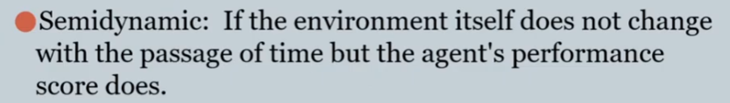
Environment Types
Characteristics
Hostile vs. friendly
Static vs. dynamic
Dynamic if the environment changes during deliberation
Discrete vs. continuous
Chess vs. driving

Slide 35
Environment types
Fully observable (vs. partially observable): An agent's sensors give it access to the complete state of the environment at each point in time.
Deterministic (vs. stochastic): The next state of the environment is completely determined by the current state and the action executed by the agent. (If the environment is deterministic except for the actions of other agents, then the environment is strategic)
Episodic (vs. sequential): The agent's experience is divided into atomic "episodes" (each episode consists of the agent perceiving and then performing a single action), and the choice of action in each episode depends only on the episode itself.

Slide 36
Environment types
Static (vs. dynamic): The environment is unchanged while an agent is deliberating. (The environment is semidynamic if the environment itself does not change with the passage of time but the agent's performance score does)
Discrete (vs. continuous): A limited number of distinct, clearly defined percepts and actions.
Single agent (vs. multiagent): An agent operating by itself in an environment.

Slide 37
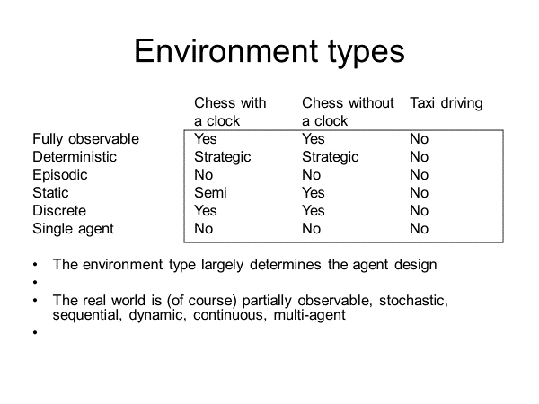

Slide 38
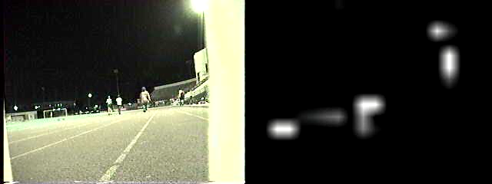
Using a look-up-table to encode f : P* → A
Example: Collision Avoidance
Sensors: 3 proximity sensors
Effectors: Steering Wheel, Brakes
How to generate?
How large?
How to select action?
obstacle
sensors
agent

Slide 39
Agent functions and programs
An agent is completely specified by the agent function mapping percept sequences to actions
One agent function (or a small equivalence class) is rational
Aim: find a way to implement the rational agent function concisely

Slide 40
Using a look-up-table to encode f : P* → A
Example: Collision Avoidance
Sensors: 3 proximity sensors
Effectors: Steering Wheel, Brakes
How to generate: for each p ∈ P_{l} × P_{m} × P_{r} generate an appropriate action, a ∈ S × B
How large: size of table = #possible percepts times # possible actions = |P_{l} | |P_{m}| |P_{r}| |S| |B| E.g., P = {close, medium, far}³ A = {left, straight, right} × {on, off} then size of table = 27*3*2 = 162
How to select action? Search.

Slide 41
Table-lookup agent
\input{algorithms/table-agent-algorithm}
Drawbacks:
Huge table
Take a long time to build the table
No autonomy
Even with learning, need a long time to learn the table entries

Slide 42
Agent types
Reflex agents
Reflex agents with internal states
Goal-based agents
Utility-based agents

Slide 43

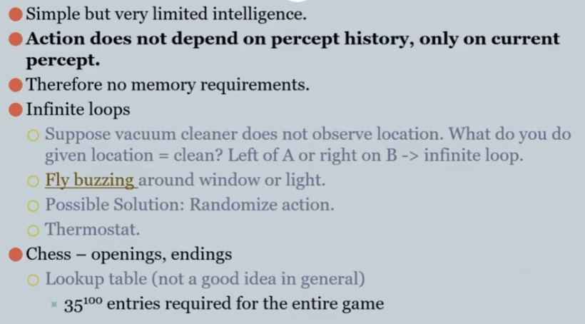

Slide 44
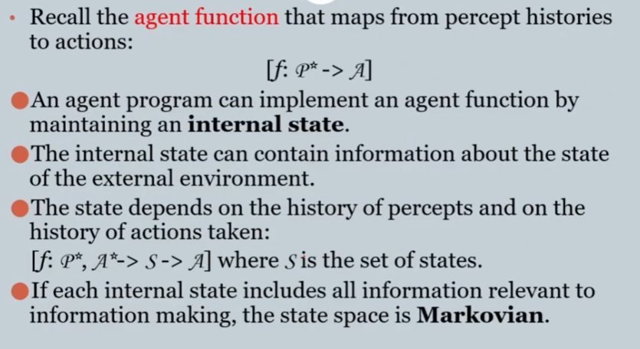
Reflex agents with internal states

Slide 45

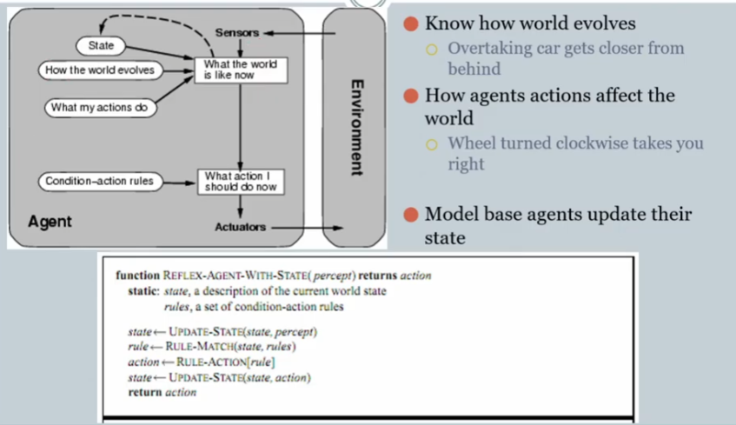

Slide 46
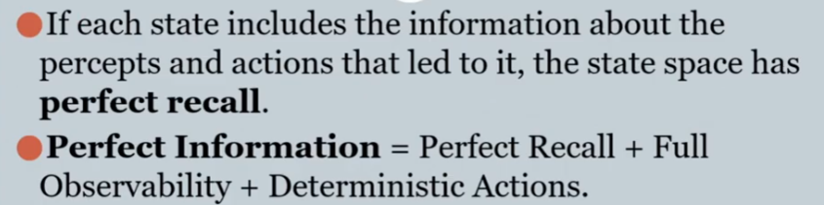
Game theory is the study of mathematical models of strategic interactions among rational agents. It has applications in all fields of social science, as well as in logic, systems science and computer science. Originally, it addressed two-person zero-sum games, in which each participant's gains or losses are exactly balanced by those of other participants. In the 21st century, game theory applies to a wide range of behavioral relations; it is now an umbrella term for the science of logical decision making in humans, animals, as well as computers.

Slide 47

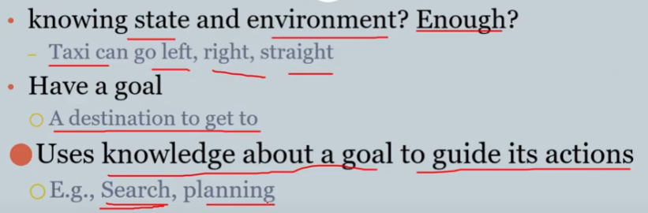
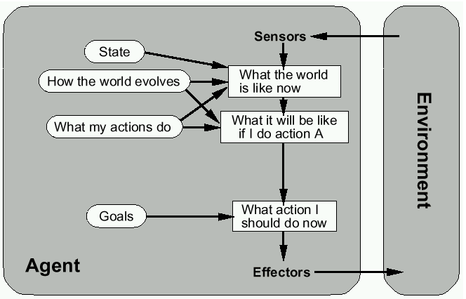

Slide 48

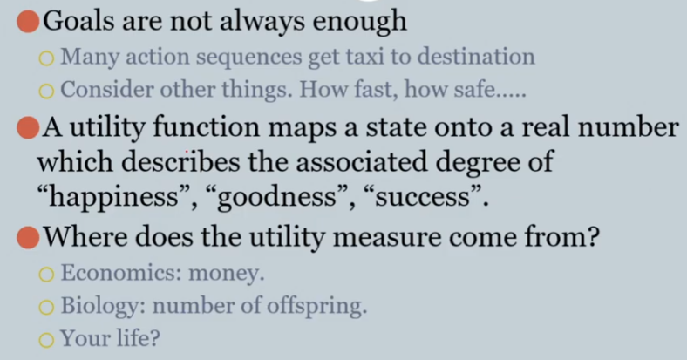
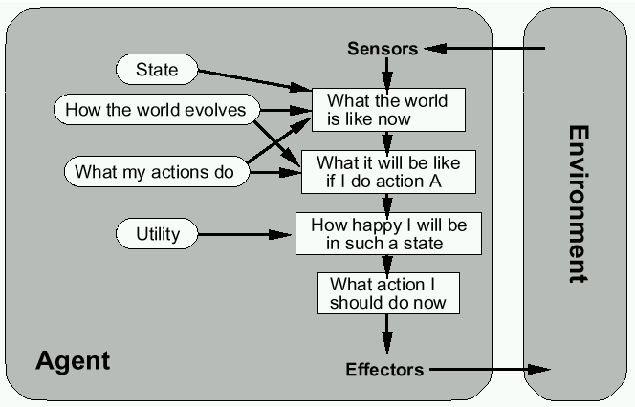

Slide 49

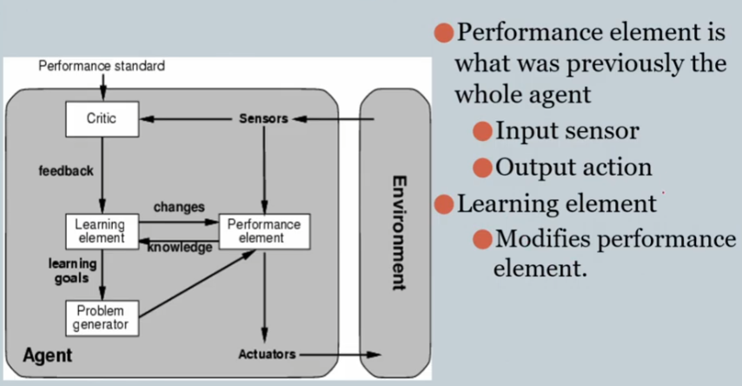
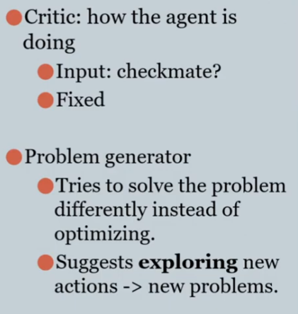

Slide 51
A learning agent has mainly four conceptual components, which are:
Learning element: It is responsible for making improvements by learning from the environment
Critic: The learning element takes feedback from critics which describes how well the agent is doing with respect to a fixed performance standard.
Performance element: It is responsible for selecting external action
Problem Generator: This component is responsible for suggesting actions that will lead to new and informative experiences.

Slide 52
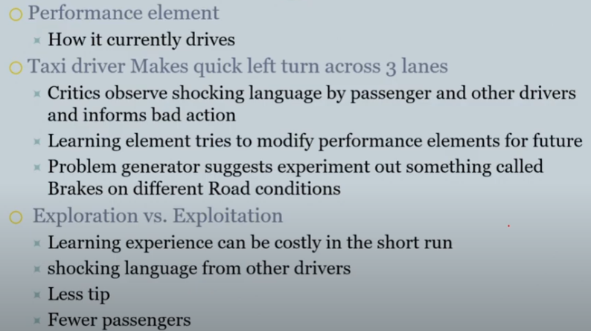

Slide 53

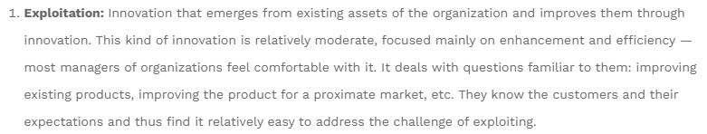


Slide 54
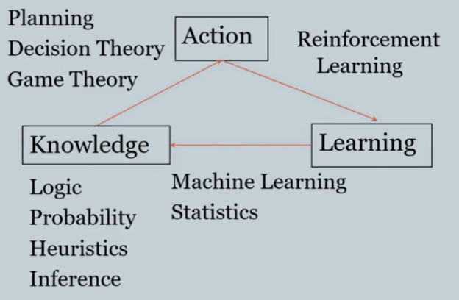
The Big Picture of IA Learning
Notes:
Reward/punishment

Slide 55
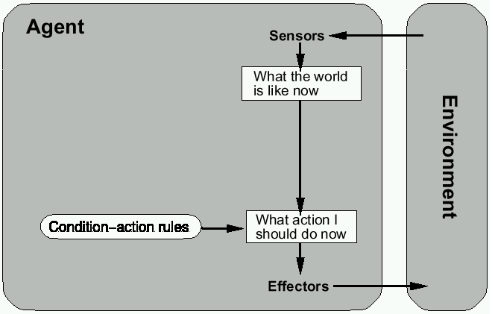
Reflex agents
If, then…
Notes:
If, then…

Slide 56
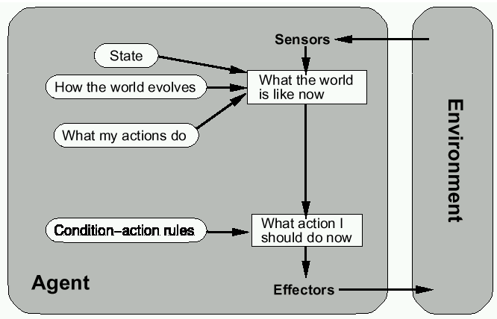
Reflex agents w/ state

Slide 57
Goal-based agents

Slide 58
Utility-based agents

Slide 59
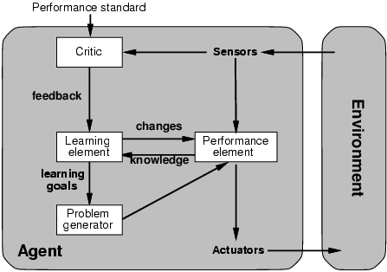
Learning agents

Slide 60
Mobile agents
Programs that can migrate from one machine to another.
Execute in a platform-independent execution environment.
Require agent execution environment (places).
Mobility not necessary or sufficient condition for agenthood.
Practical but non-functional advantages:
Reduced communication cost (eg, from PDA)
Asynchronous computing (when you are not connected)
Two types:
One-hop mobile agents (migrate to one other place)
Multi-hop mobile agents (roam the network from place to place)
Applications:
Distributed information retrieval.
Telecommunication network routing.

Slide 61
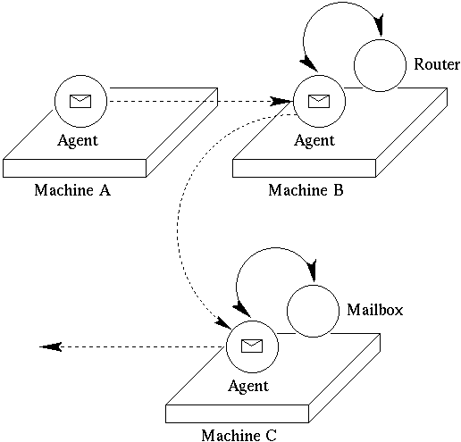
Mobile agents
Programs that can migrate from one machine to another.
Execute in a platform-independent execution environment.
Require agent execution environment (places).
Mobility not necessary or sufficient condition for agenthood.
A mail agent

Slide 62
Mobile agents
Practical but non-functional advantages:
Reduced communication cost (e.g. from PDA)
Asynchronous computing (when you are not connected)
Two types:
One-hop mobile agents (migrate to one other place)
Multi-hop mobile agents (roam the network from place to place)

Slide 63
Mobile agents
Applications:
Distributed information retrieval.
Telecommunication network routing.

Slide 64
Vacuum-cleaner world
Percepts: Location and status, e.g., [A,Dirty]
Actions: Left, Right, Clean, NoOp
Example vacuum agent program:
function Vacuum-Agent([location,status]) returns an action
if status = Dirty then return Clean
else if location = A then return Right
else if location = B then return Left

Slide 65
Rational agents
For each possible percept sequence, a rational agent should select an action that is expected to maximize its performance measure, given the evidence provided by the percept sequence and the agent’s built-in knowledge
Performance measure (utility function): An objective criterion for success of an agent's behavior
Can a rational agent make mistakes?
Notes:
ExpectedUtility(action) = sum_outcomes Utility(outcome) * P(outcome)

Slide 66
Back to vacuum-cleaner world
Percepts: Location and status, e.g., [A,Dirty]
Actions: Left, Right, Clean, NoOp
function Vacuum-Agent([location,status]) returns an action
if status = Dirty then return Clean
else if location = A then return Right
else if location = B then return Left
Is this agent rational?
Depends on performance measure, environment properties

Slide 67
Agent: Spam filter
Performance measure
Minimizing false positives, false negatives
Environment
A user’s email account, email server
Actuators
Mark as spam, delete, etc.
Sensors
Incoming messages, other information about user’s account

Slide 68
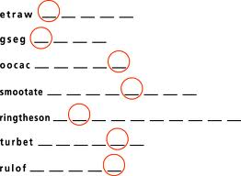
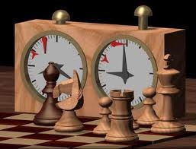
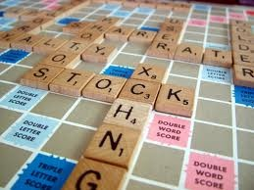
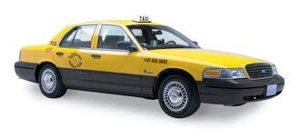
Examples of different environments
Word jumble solver
Chess with a clock
Scrabble
Taxi driving
Fully
Fully
Partially
Partially
Observable
Deterministic
Episodic
Static
Discrete
Single agent
Deterministic
Strategic
Stochastic
Stochastic
Episodic
Sequential
Sequential
Sequential
Static
Semidynamic
Static
Dynamic
Discrete
Discrete
Discrete
Continuous
Single
Multi
Multi
Multi

Slide 69
Summary
Intelligent Agents:
Anything that can be viewed as perceiving its environment through sensors and acting upon that environment through its effectors to maximize progress towards its goals.
PAGE (Percepts, Actions, Goals, Environment)
Described as a Perception (sequence) to Action Mapping: f : P* → A
Using look-up-table, closed form, etc.
Agent Types: Reflex, state-based, goal-based, utility-based
Rational Action: The action that maximizes the expected value of the performance measure given the percept sequence to date

